Slide 1
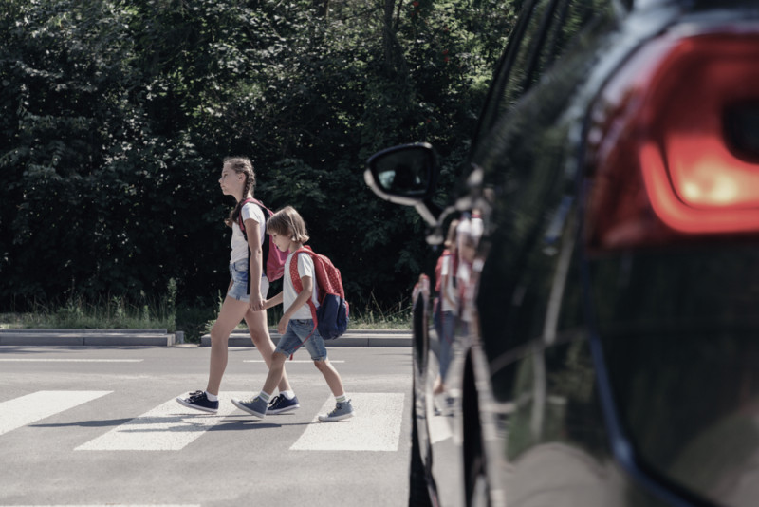
PEDESTRIAN DETECTION AND MONITORING SYSTEM
PSM 1 PRESENTATION
FARABI TASNIM AHMED
(B031910456)
BITI S1G1,FTMK
SUPERVISOR: PM GS. DR. ASMALA BIN AHMAD
EVALUATOR:PROF.DR.AZAH KAMILAH BINTI DRAMAN@MUDA

Slide 2



Introduction
Pedestrian detection & monitoring system utilizes cameras in order to acquire information of the vehicle surroundings by video. Through the acquired video footage, it will conduct semantic understanding of the vehicle surroundings and detect pedestrians. Then, it will calculate the total number of pedestrians and track their distance. Upon crossing a fixed distance limit, the system will alert the driver of the car that a car or pedestrian is too close to their cars.

Slide 3
Problem Statements
Safety issue - Both pedestrians and drivers may lose their lives or be physically disabled in deadly car accidents and may even be found dead on the spot
Absence of focus - Drivers frequently lose focus when driving, leading in a lack of awareness of pedestrians on the road, which can result in tragic crashes and accidents
Loss of lives - Pedestrians may be oblivious of fast-moving vehicles that could collide with them causing loss of lives
Errors in manual guidance - Driving in a manual mode is prone to errors and time consumption, it can occasionally lead to last-minute decision-making, putting the lives of passengers and pedestrians at risk

Slide 4

Objectives
To identify the requirements of an intelligent pedestrian and car surveillance system.
To develop an intelligent pedestrian and car surveillance system.
To evaluate the performance of the developed intelligent pedestrian and car surveillance system.

Slide 5
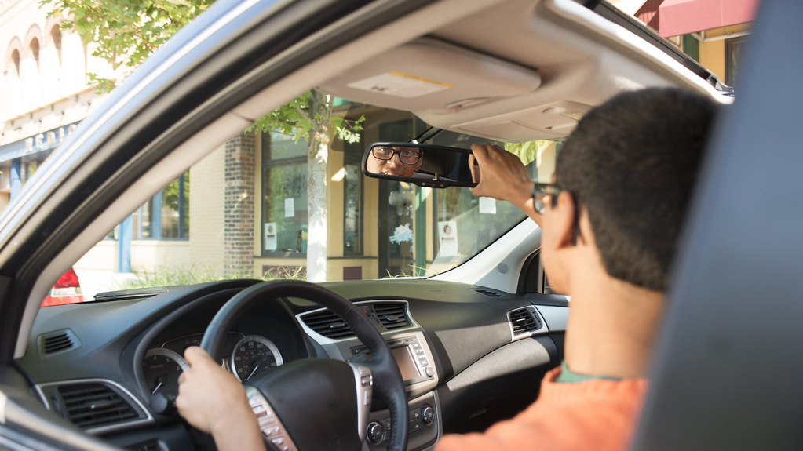
Target Users
Drivers of autonomous vehicles

Slide 6
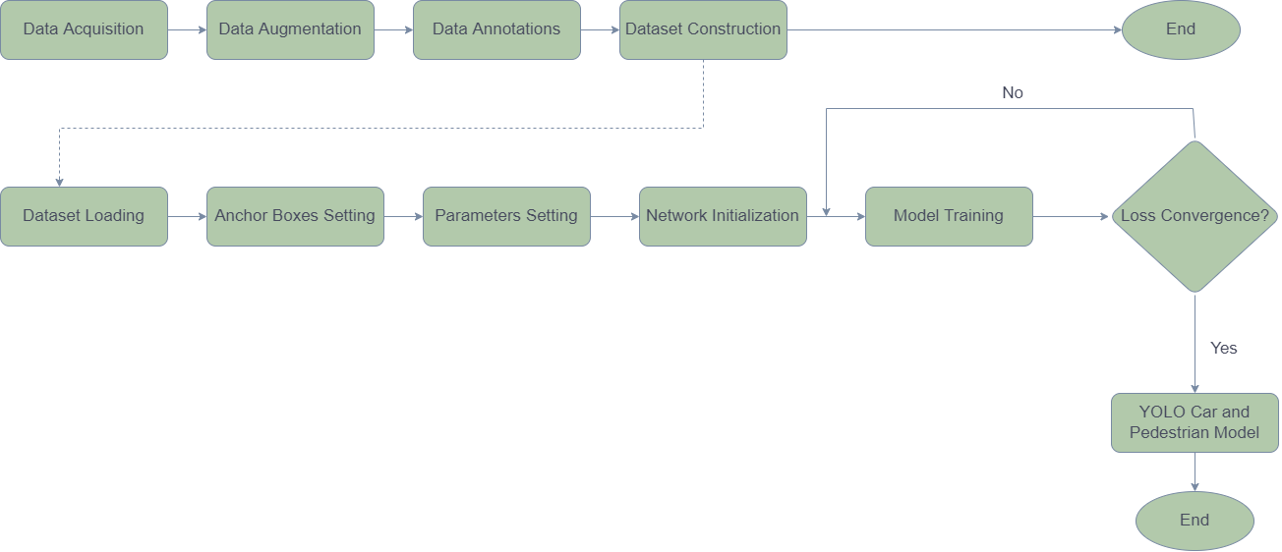
Project Workflow

Slide 7
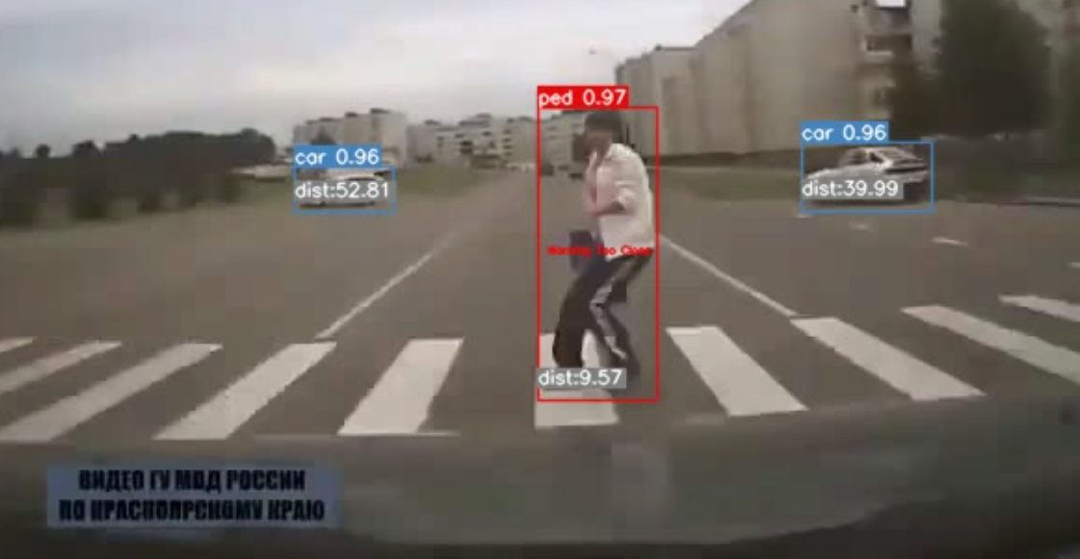
Results
DAYTIME PREDICTIONS

Slide 8
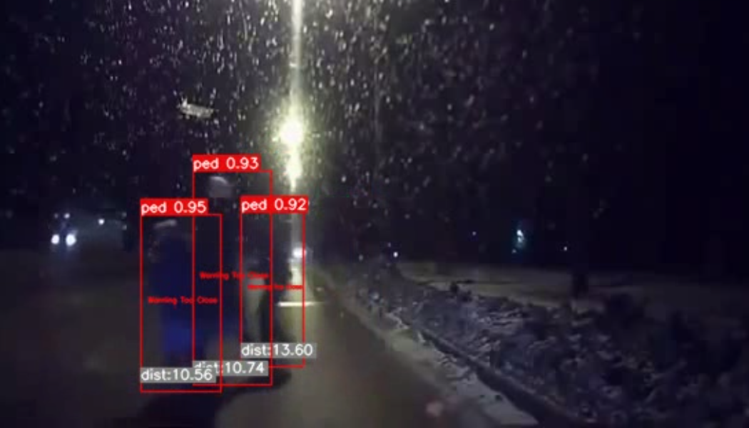
Results
NIGHTTIME PREDICTIONS

Slide 9
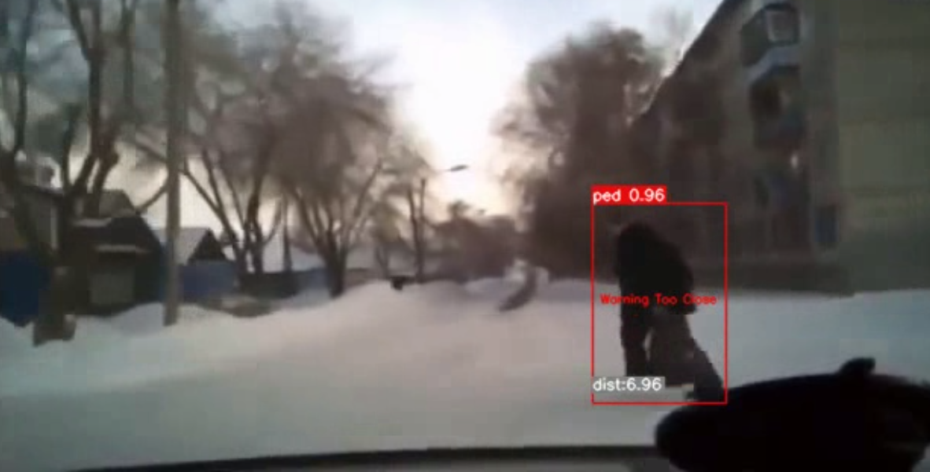
Results
PREDICTIONS ON BLURRY IMAGES

Slide 10
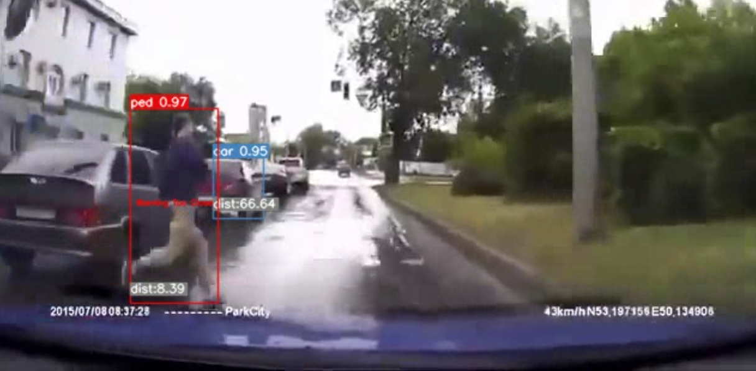
Results
PREDICTIONS ON RAINY WEATHER

Slide 11
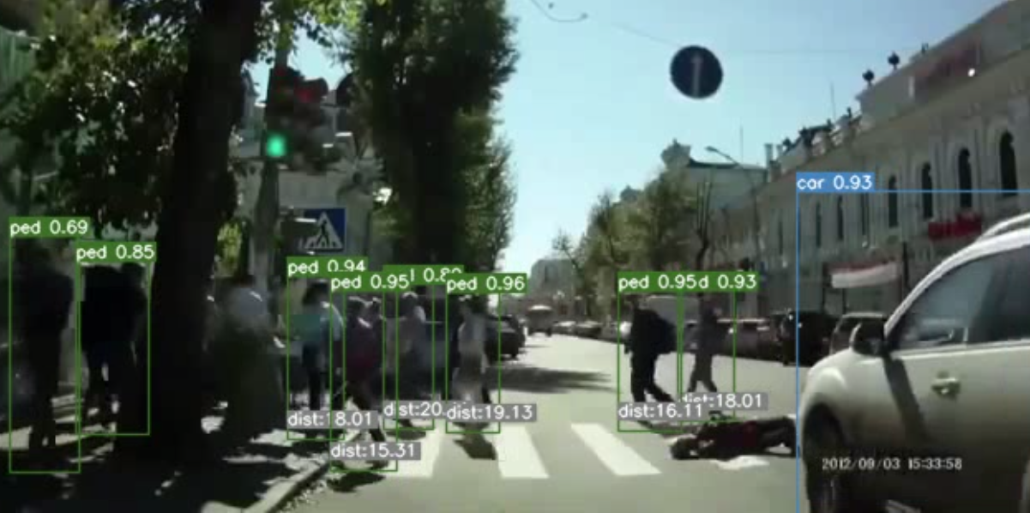
Results
PREDICTIONS ON MULTIPLE PEDESTRIANS

Slide 12
Strength and Limitations
Strengths
Limitations
In terms of mean average precision (mAP) and intersection over union (IOU) values, YOLO has high accuracy.
YOLO is a state-of-the-art technique known for its higher speed compared to other models.
YOLO is also aware of the concept of generalized object representation.
Due to absence of GPU , the speed of the proposed system is a bit slow.
The way YOLO detect objects it faces difficulty it detecting smaller objects.
Like other deep learning algorithms YOLO face hard time to detect objects that are different or have unusual appearance than the remaining training set.

Slide 13

Conclusion
The goal of building this intelligent video surveillance system is to keep passengers and pedestrians safe on the road by averting accidents. The technology functions as a driver's vision that identifies pedestrians. It then estimates the distance between the car and the pedestrian after recognizing the pedestrian. In a nutshell, it functions as a driver's eye and uses superior artificial intelligence technology to protect people's lives

Slide 14


Let's proceed with demonstration Thank You

